Slide 1
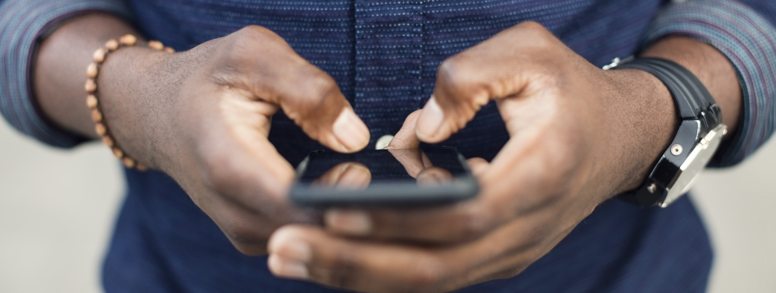
INSTAGRAM ANALYTICS
- SWAGATIKA SAMAL

Slide 2


PROBLEM STATEMENT
Assuming myself as a data analyst, I will be working with the product team at Instagram.
This role involves analyzing user interactions and engagement with the Instagram app to provide valuable insights that can help the business flourish.
User analysis involves tracking how users engage with a digital product, such as a software application or a mobile app. The insights derived from this analysis can be used by various teams within the business. For example, the marketing team might use these insights to launch a new campaign, the product team might use them to decide on new features to build, and the development team might use them to improve the overall user experience.

Slide 3
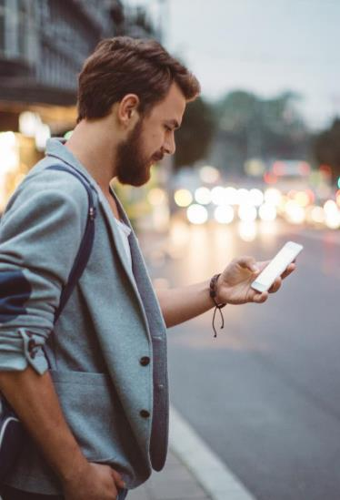
AGENDA
Identify the five oldest users on Instagram from the provided database.
Identify users who have never posted a single photo on Instagram.
Determine the winner of the contest and provide their details to the team.
Identify and suggest the top five most commonly used hashtags on the platform.
MARKETING ANALYSIS
Determine the day of the week when most users register on Instagram. Provide insights on when to schedule an ad campaign.

Slide 4
AGENDA
Calculate the average number of posts per user on Instagram. Also, provide the total number of photos on Instagram divided by the total number of users.
Identify users (potential bots) who have liked every single photo on the site, as this is not typically possible for a normal user.
INVESTOR METRICS

Slide 5
TECH- STACK USED
I have used MySQL Workbench 8.0 to execute the project.

Slide 6


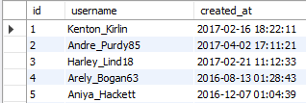
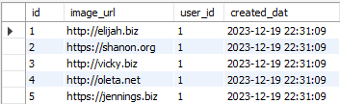
DATABASE USED
I have created ig_clone database containing multiple tables such as users, comments, follows, likes, photos, tags and photo_tags.

Slide 7
APPROACH
MARKETING ANALYSIS
For marketing analysis, I have used following tables from ig_clone database:
users, photos, photo_tags, likes
In the upcoming slides we can see how we have solved each querry using SQL.

Slide 8
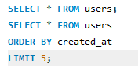

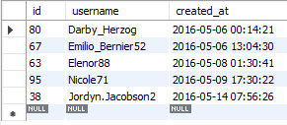
Identify the five oldest users on Instagram from the provided database.

Slide 9
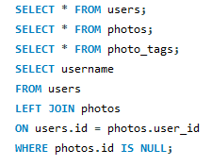
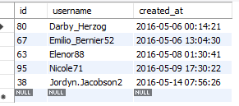
Identify users who have never posted a single photo on Instagram.

Slide 10
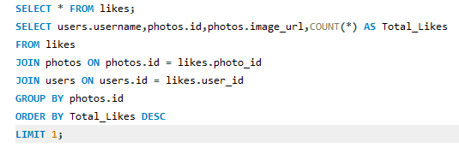
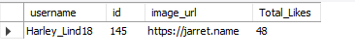
Determine the winner of the contest and provide their details to the team.

Slide 11
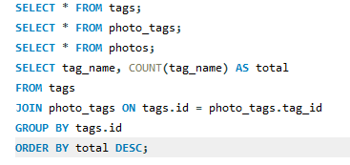
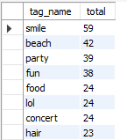
Identify and suggest the top five most commonly used hashtags on the platform.

Slide 12
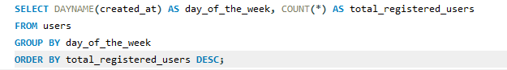
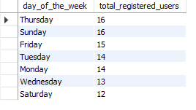
Determine the day of the week when most users register on Instagram. Provide insights on when to schedule an ad campaign.

Slide 13
APPROACH
INVESTOR METRICS
To provide valueable insights to the investors, I have used following tables from ig_clone database:
users, photos, likes
In the upcoming slides we can see how we have solved each querry using SQL.

Slide 14

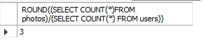
Provide the total number of photos on Instagram divided by the total number of users.

Slide 15
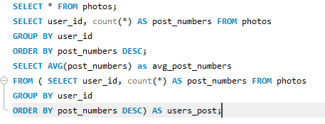
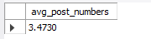
Calculate the average number of posts per user on Instagram.

Slide 16
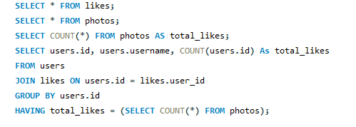
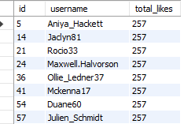
Identify users (potential bots) who have liked every single photo on the site, as this is not typically possible for a normal user.

Slide 17
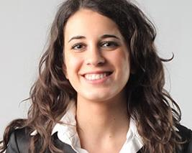
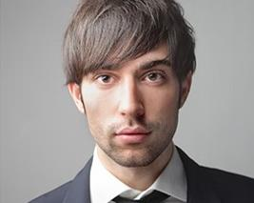
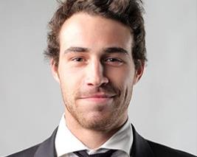
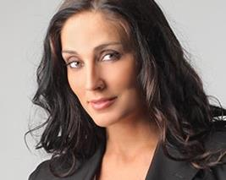
INSIGHTS
This project helped me to gain valuable insights from each querry I resolved. Following are the major highlights:
Through the analysis, I could also be able to identify most popular hashtags used in the platform.
This helps any brand marketing company to use those hashtags to reach out more target audience.
Through the analysis I could able to find the day when most users tend to login.
This helps to launch the ad campaigns in that particular day which can impact maximum number of users.
Through the analysis, I could able to identify the users using Instagram from a longest period of time.
Rewarding loyal users through marketing campaign can help in converting other users being loyal.
I could also provide insights to the investor by identifying number of users liking each and every photograph posted.
This helps the investors to find out fake users crowding the platform.

Slide 18
AGENDA
SUMMARY
Through this project, I gained an understanding of the process involved in making data-driven decisions as a business or data analyst, particularly in the context of working with real-time data.
Utilizing SQL, I conducted an in-depth analysis of user data from Instagram, addressing pivotal queries that influence strategic decision-making. This experience has furnished me with valuable insights to drive well-informed business decisions.
This initiative provides Instagram's product and leadership teams with strategies supported by data, thereby boosting user engagement and fostering growth.

